Slide 1

“Final Review of Major Project”
for E-4 (2016)
Submitted as part of Major Project
Authenticated and Secured Data Exchange by Digital Ledger
V. Jaya Pushpa Sri (S160492)
D. Divya (S160842)
A. Sruthi Chowdary (S160933)
K. S. Mounika (S160055)
Under the Supervision of:
Ms. Roopa Musidi,
Assistant Professor,
Department of Computer Science and Engineering
Email: roopamusidi@rguktsklm.ac.in

Slide 2
Authenticated and Secured Data Exchange by Digital Ledger

Slide 3
Contents
Abstract
Introduction
Technologies Used
Problem statement
Implementation
Proposed system
Advantages
Existing system
Result
Conclusion
References

Slide 4
Abstract
Communication is very important to maintain effective coordination and collaboration by exchanging data. While exchanging the data, Data Control, End-to-End Encryption, Cross-Communication, Device Compatibility, Compliance Capabilities, Advanced Administrative Controls, Open Communication, Transparency with Users, and A Zero Trust Practice are considered for secure and effective communication. Existing data-sharing platforms depend on trusted third parties (TTP). Due to the involvement of TTP, such systems lack trust, transparency, security, and immutability. To overcome these issues, we propose a blockchain-based secure data sharing platform by leveraging the benefits of the interplanetary file system (IPFS). To acquire the file/data, an authenticated and authorized receiver has to use transactions and interact with the system in four phases, including the data transfer request, encrypted data transfer, key retrieval, and data decryption. Compared with related work, the system can perform the four phases autonomously. It utilizes the permissioned blockchain, i.e. Hyperledger, for access control and can defeat dishonest receivers. We use asymmetric algorithm (RSA), SHA-512 for hashing, End to End encryption and consensus algorithms (Proof of work, Proof of authority) to keep records of every transaction developed in Python.
Keywords: Block Chain , Interplanetary File System, Hyperledger, Proof of work , Proof of authority.

Slide 5
Introduction
In this project we use cryptography and blockchain to transfer files securely by providing proof to it such that it assures authentication and data security for every data exchange. Even though existing data-sharing platforms using trusted third parties are used in file transfer, they lack trust, transparency, security, and immutability. This project can demonstrate how the data exchange can be done more securely. In our project, we develop a framework that could make every transaction more authenticated, secured, transparent and immutable.

Slide 6
Technology Used
Block chain
Transparency with Users and A Zero Trust Practice
To make a secured network and transparent ledger
Cryptography
End to end encryption for secure data exchange

Slide 7
Problem statement
Most of the data-sharing platforms depend on trusted third parties (TTP). Due to the involvement of TTP, such systems lack trust, transparency, security, and immutability. To overcome these issues, this model is developed using Digital Ledger by leveraging the benefits of the interplanetary file system (IPFS) in blockchain.

Slide 8
Implementation
End to End Encryption : RSA Algorithm
Hashing Algorithm : SHA512
Blockchain implementation : Python
API : FastAPI
Asynchronous Server Gateway Interface : uvicorn

Slide 9
Proposed System
Metadata / Blocks Data / Ledgers
Cloud
Encrypted Data
System
Encrypted Data
Sender
Receiver
Data
Encryption
Decryption
Data
Public Key
Private Key

Slide 10
Advantages
Data security by End to end encryption
Transparency with users
Data control
Zero trust practice
Immutability of data

Slide 11
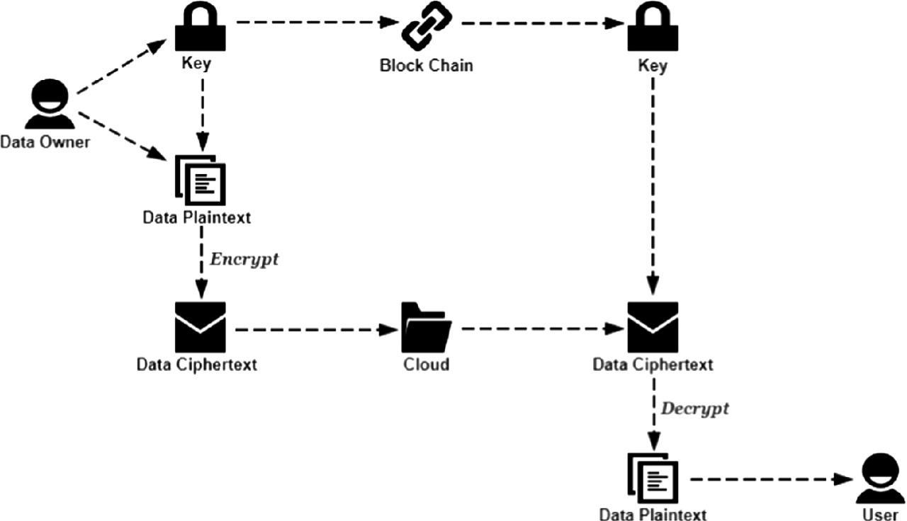
Transaction Model
User Account

Slide 12
Block Chain
Genesis Block
Transaction
Block 1
Transaction
Block 2
Transaction
Block N
Transaction
Index
Time Stamp
Data (Encrypted)
Proof
Previous Hash(0)
Sender ID
Receiver ID
Index
Time Stamp
Data (Encrypted)
Proof
Previous Hash
Sender ID
Receiver ID
Index
Time Stamp
Data (Encrypted)
Proof
Previous Hash
Sender ID
Receiver ID
Index
Time Stamp
Data (Encrypted)
Proof
Previous Hash
Sender ID
Receiver ID
.........

Slide 13
Existing System
Data sharing platforms depend on trusted third parties
Cloud
Third Party
Software
End User/
Device
End User/
Device

Slide 14
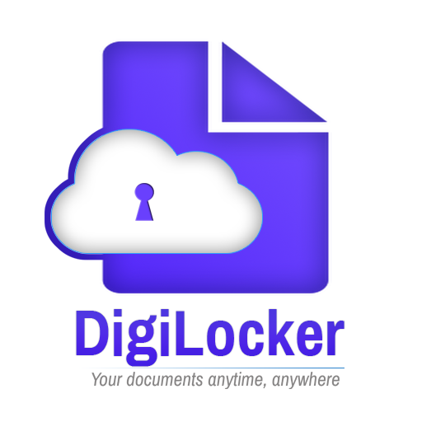

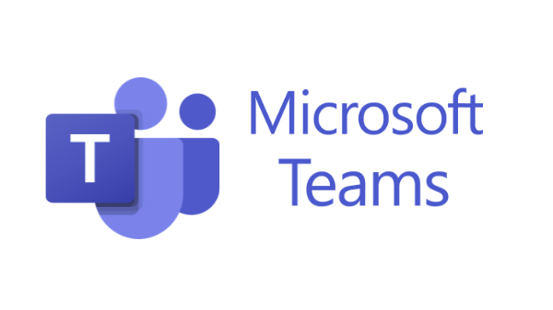
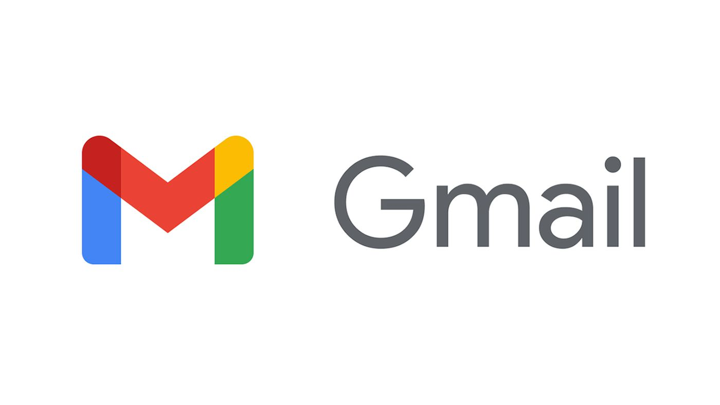
Existing Systems (Cont…)

Slide 15
Drawbacks of Existing System
No transparency
Lack of trust by TTP
Administrative controls
Possibility of data leak and data loss

Slide 16
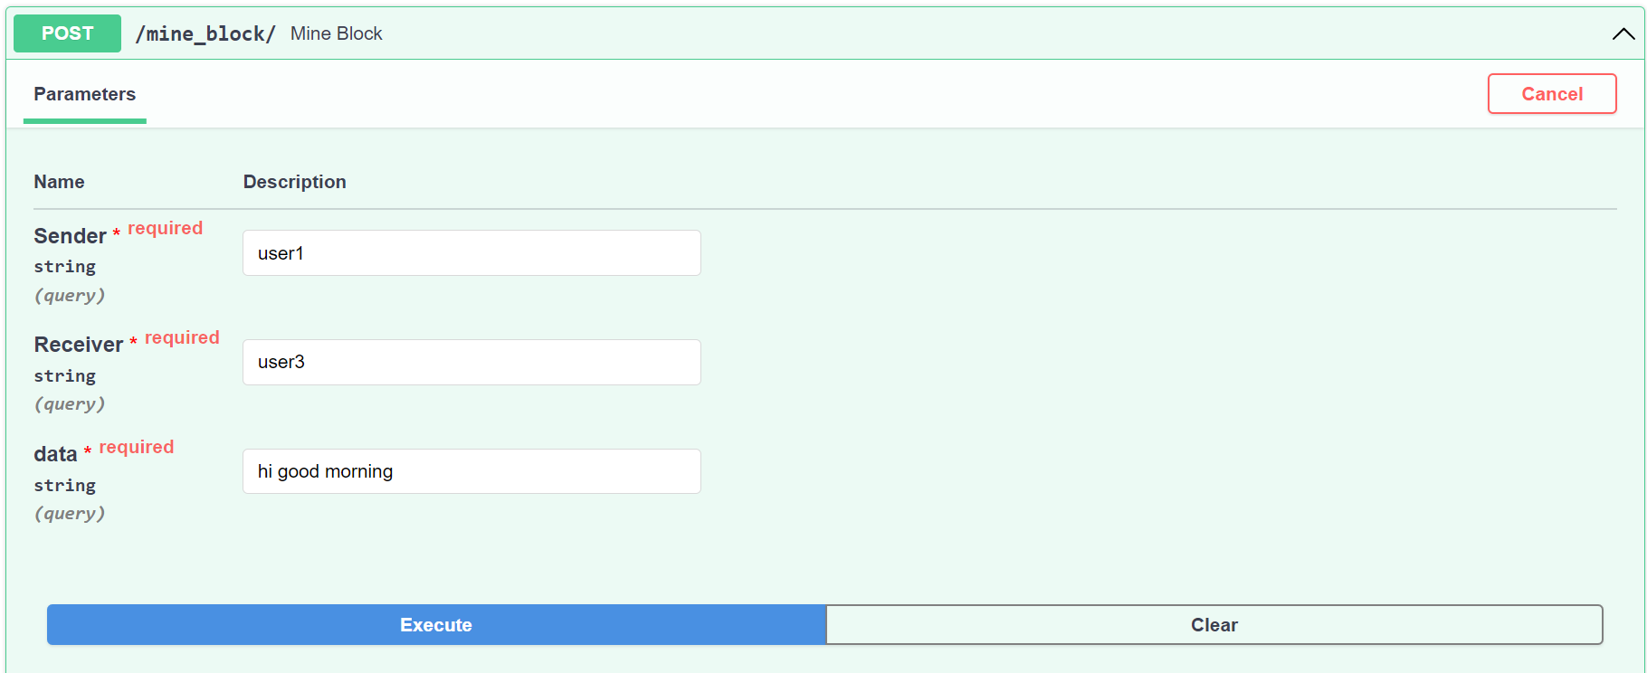
Results

Slide 17
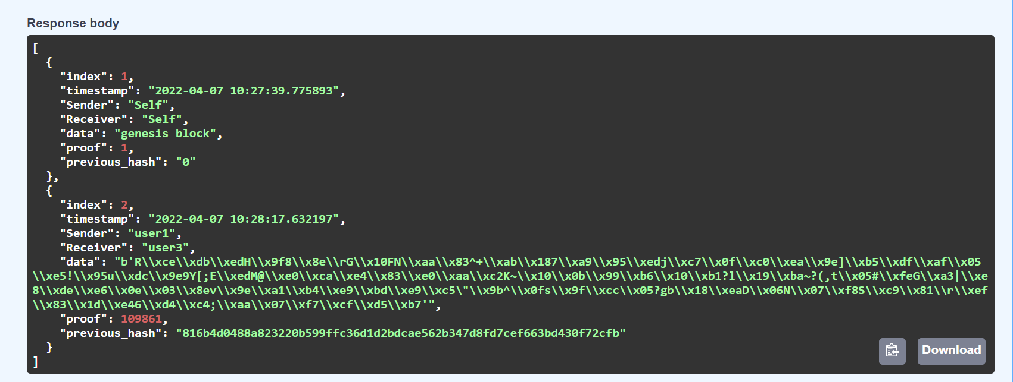
Results (Cont…)

Slide 18
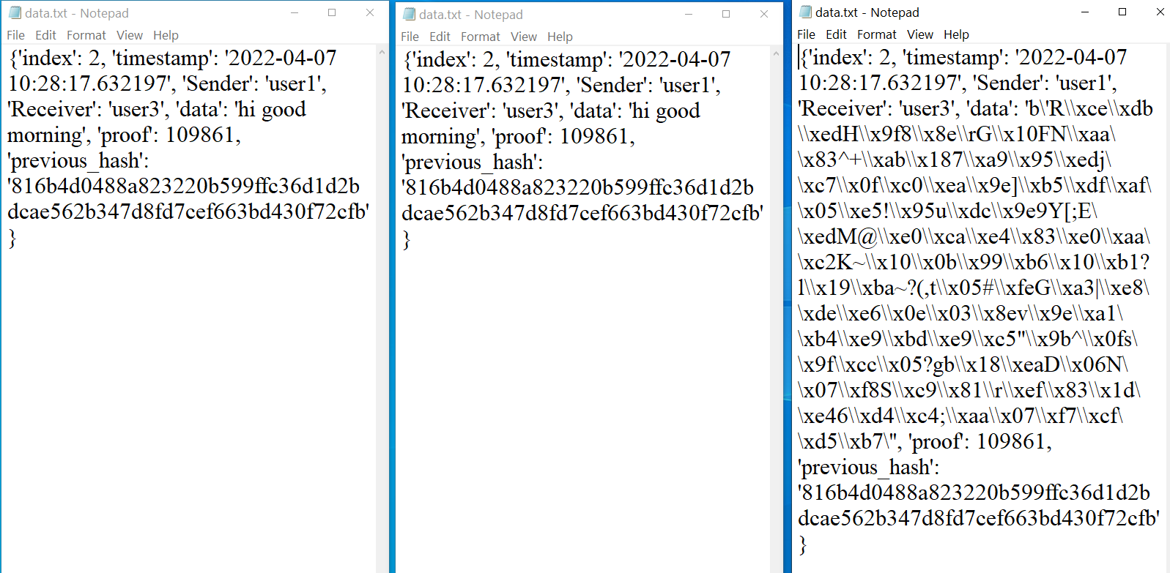
User1 User3 User2
Output:
.

Slide 19
Conclusion
By developing this model, we can ensure the following :
Secured data transfer
Transparent system for users
Proof of transfers by ledgers

Slide 20
References
S.No | Author and Year | Title of the reference paper | Reference link | Analysis
1. | Shan Wang, Ming Yang , Tingjian Ge , Yan Luo, Xinwen Fu in 2021 | BBS: A Blockchain Big-Data Sharing System | https://cs.paperswithcode.com/paper/bbs-a-blockchain-big-data-sharing-system | Secured data transfer using blockchain technology
2. | Yongkai Fan, Jinghan Wang, Zhenting Hong, Xia Lei, Fanglue Xia, Junjie Ma, Cong Peng & Xiaofeng Sun in 2019 | A Blockchain based Data Sharing architecture | https://link.springer.com/chapter/10.1007/978-981-15-2777-7_52 | Architecture of the blockchain based file sharing system
.

Slide 21
References (Cont…)
.
S.No | Author and Year | Title of the reference paper | Reference link | Analysis
3. | Nitesh Singh, Jay Bothra, Sandeep Kothale in 2018. | Blockchain Based Data Sharing Framework | https://www.irjet.net/archives/V5/i12/IRJET-V5I12268.pdf | Framework of blockchain based data sharing system

Slide 22
THANK YOU

